Slide 1

Anharmonic energy Calculation of Clathrate Hydrate
Weisong Lin

Slide 2

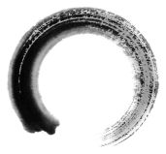
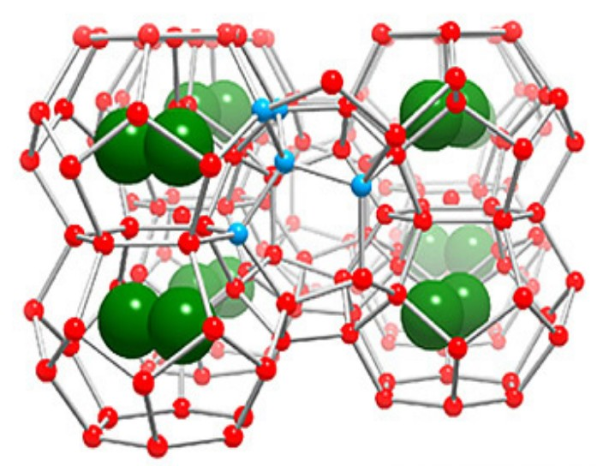
1
introduction
What is Clathrate hydrate?
Crystalline structures that consist of water molecules forming cages via a hydrogen-bonding network enclosing small guest molecules.
Clathrate hydrate^{[1]}

Slide 3
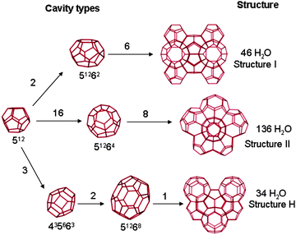
1
introduction
Structure of Clathrate hydrate
Gas hydrates usually form three crystallographic cubic structures: structure I(SI) and structure II(SII) and Structure H(SH). Each type are formed of two or three small cages^{[2]}:
Notes:
J. W. Steed and J. L. Atwood, Supramolecular Chemistry, Wiley, 2nd edn, 2009

Slide 4
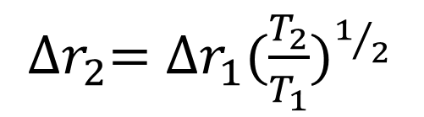
2
Formalism and method (HTTP method)
We Introduce harmonically targeted temperature perturbation^{[3]} (HTTP) method to calculate free energy difference at two different temperature.
Within the harmonic system, displacement is proportional to square root of temperature.
${∆r}_{2}={∆r}_{1}{(\frac{T_{2}}{T_{1}})}^{1/2}$
Ratio of energy to temperature, U/T would be unchanged. The perturbation average would indicate a zero free-energy difference.
Monte Carlo measurement = anharmonic contribution
We can perform a series of free energy perturbations from low T(—>0) to the temperature we are interested in.

Slide 5
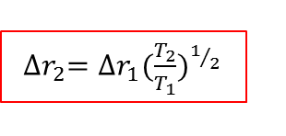
2
Formalism and method(HTTP formulas)
The basic perturbation theory working equation:
${∆r}_{2}={∆r}_{1}{(\frac{T_{2}}{T_{1}})}^{1/2}$
For translation contribution:
—displacement from lattice Site
However, for rotation contribution
—rotation angle
Notes:
to be appropriate to the perturbed Hamiltonian.
Less straight forward.

Slide 6
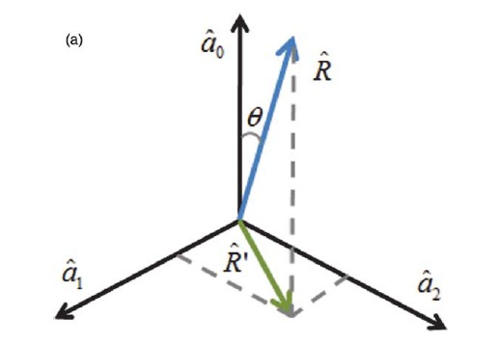
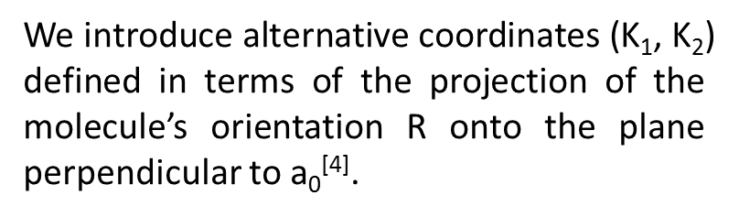
2
Formalism and method (rotation transformation)
We introduce alternative coordinates ($\text{Κ}$₁, Κ₂) defined in terms of the projection of the molecule’s orientation R onto the plane perpendicular to a₀^{[4]}.
rotation
translation
Notes:
The 2-D could be intergraded but 3-D could not be intergraded
Draw pic here

Slide 7
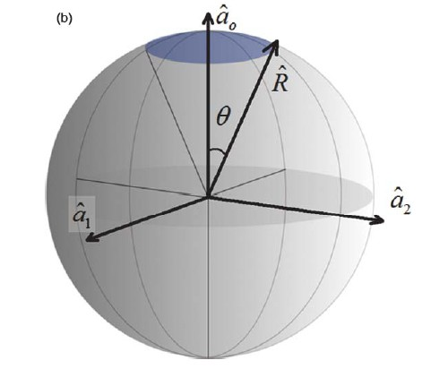
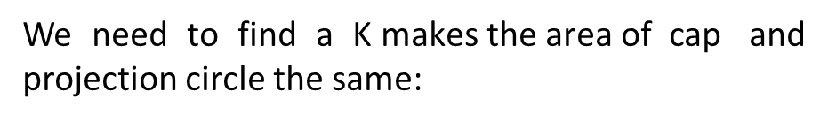
2
Formalism and method (linear molecule, like N₂ )
In particularly
We need to find a $\text{Κ} \text{makes} \text{the} \text{area} \text{of} \text{cap}$ and projection circle the same:
Circle:
Cap:
Notes:
Ao a1 a2 forms an oth
K coordinates are better suited than theta and phi for forming the hessian matrix needed for harmonic analysis
Instead we introduce alternative
coordinates (*1, *2) defined in terms of the projection of the
molecule’s orientation ˆR onto the plane perpendicular to ˆa0

Slide 8
2
Formalism and method (nonlinear molecule, like H₂0)
For H₂o, we need to use the same idea in 4D quaternion^{[5]} space
or
$in which θ$ is half of the overall rotation angle $α (θ=α/2)$
$$transformation are similar:$$
What would the projection of hyperspherical cap be like?
a₃
Notes:
5. http://en.wikipedia.org/wiki/Quaternion

Slide 9
2
Formalism and method (nonlinear molecule, like H₂0)
Similarly two area should be the same, but projection of
sphere:
Hyperspherical Cap^{[6]}:

Slide 10
2
Formalism and method (final expression)

Slide 11
2
Formalism and method (rotation axis and angle)
Nominal orientation matrix: R₀ (a₀ a₁ a₂)
Molecule’s orientation matrix: R (R₀ R₁ R₂)
orientation matrix^{[7]}: M
R=MR₀ or M=RR_{o}⁻¹
—eigentvector of rotation matrix with eigenvalue is 1

Slide 12
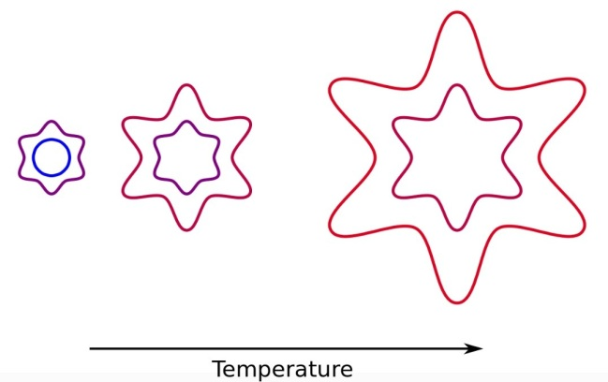
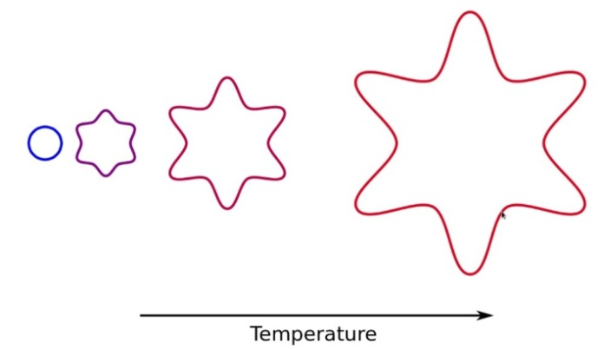
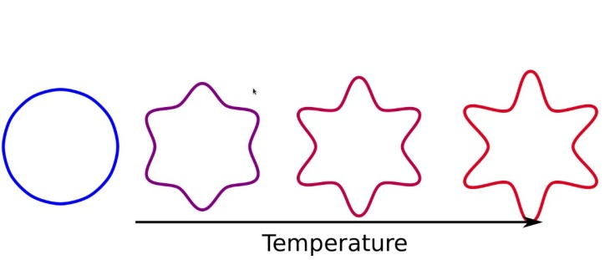
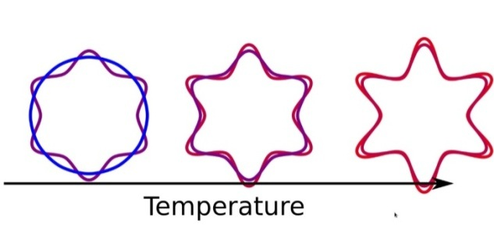
3
Result analysis (better precision^{[8]})
FEP: Configuration space increases rapidly with temperature.
ΔβA is too big
HTTP: Scale out the change in size we expect
ΔβAc is smaller

Slide 13
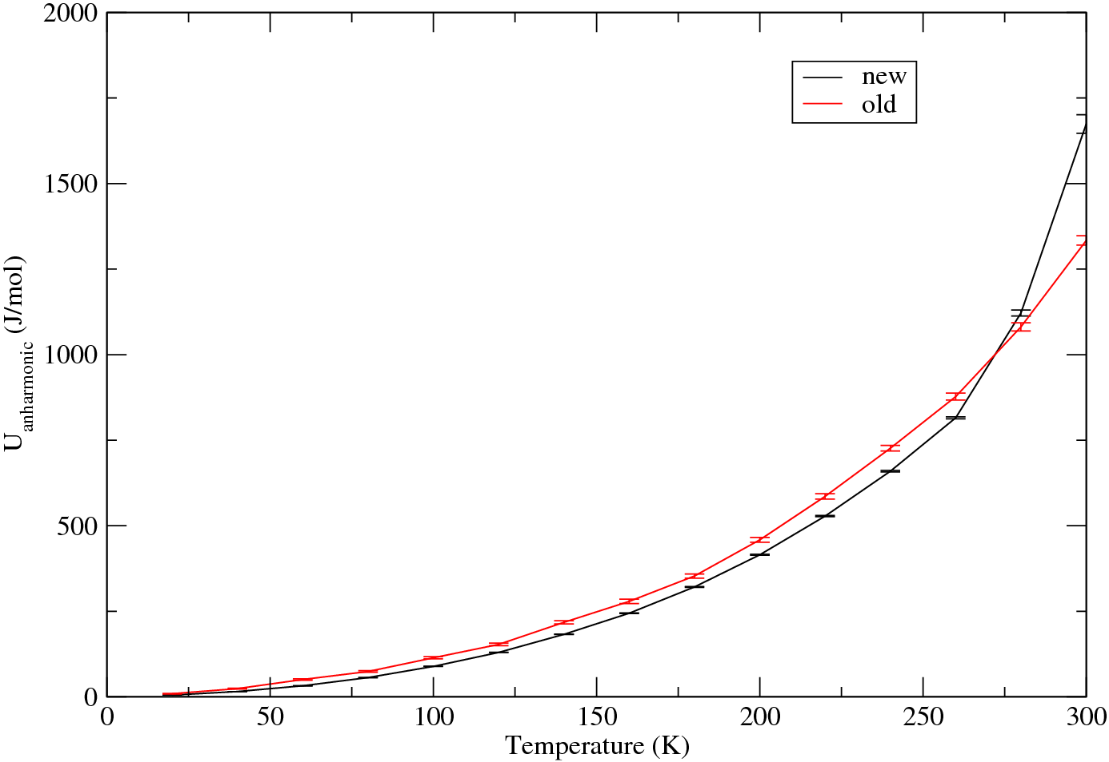
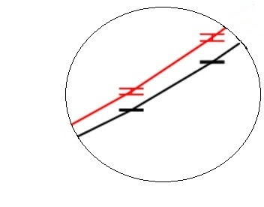
2
Formalism and method (better precision)
Anharmonic PE of 2*2*2 Unit Cells

Slide 14
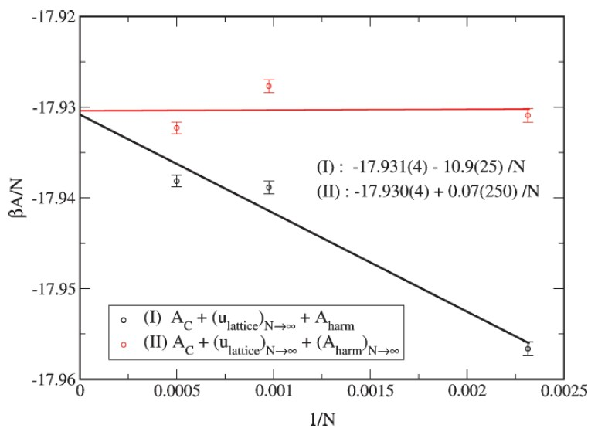
3
Result analysis (system size dependence ^{[3]} )
The black line labeled (I) :
lattice for infinite system
Harmonic and anharmonic in N dependence.
Conventional method
The red line labeled (II) :lattice energy and harmonic for infinite system while only anharmonic in N dependence
HTTP method

Slide 15
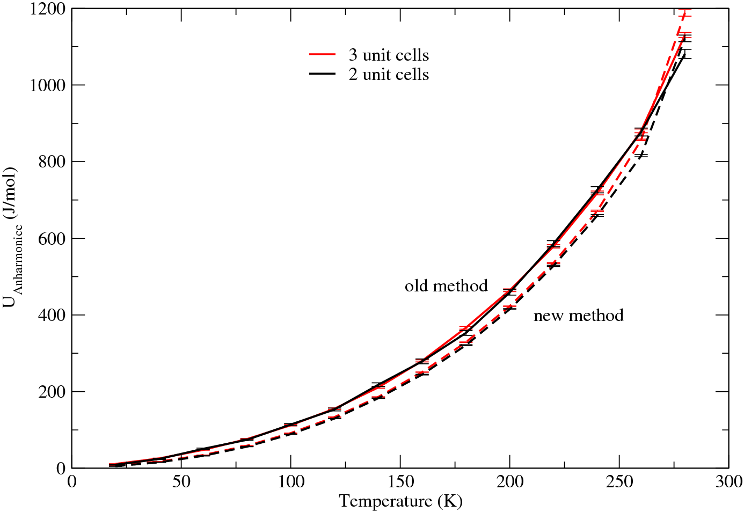
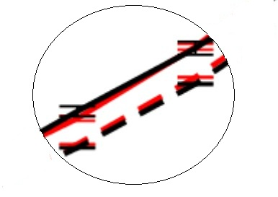
3
Result analysis (system size dependence for water )
Anharmonic PE
3*3*3
2*2*2

Slide 16
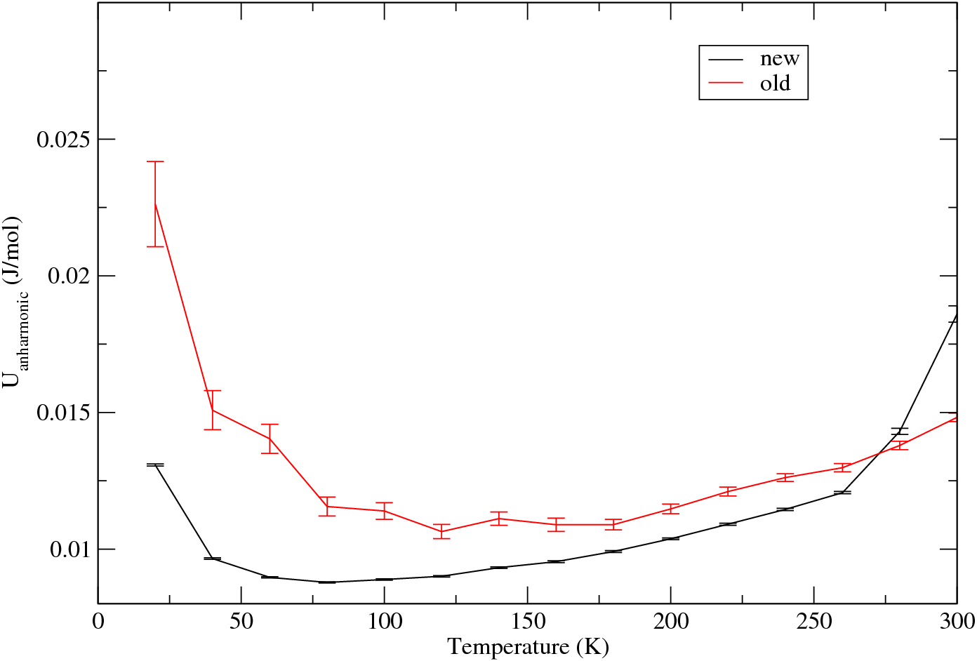
3
Result analysis
Anharmonic PE divided by T²
2*2*2 cells

Slide 17
4
Conclusions
HTTP method shows higher precision than conventional method(FEP)
however:
Results of both two methods do not agree with each.
Conventional method should have bigger System Size effect
Possible reason: the initial configuration is not minimized
Notes:
our next goal :
1. find out how the Anharmonic potential energy change with temperature

Slide 18
5
References
1. http://ps.uci.eduscholarkcjandaresearchgas-hydrate-structure
2. J. W. Steed and J. L. Atwood, Supramolecular Chemistry, Wiley, 2nd edn, 2009
3. Tan, T. B.; Schultz, A. J.; Kofke, D. A., J. Chem. Phys. 4. Tan, T. B.; Schultz, A. J.; Kofke, D. A., Efficient calculation of α- and β-nitrogen free energies and coexistence conditions via overlap sampling with targeted perturbation.
5. http://en.wikipedia.org/wiki/Quaternion
6. Li, S. (2011). "Concise Formulas for the Area and Volume of a Hyperspherical Cap". Asian J. Math. Stat.
7. http://en.wikipedia.org/wiki/Rotation_matrix
8. http://rheneas/~andrew/http/HTTP.xhtml
Notes:
our next goal :
1. find out how the Anharmonic potential energy change with temperature

Slide 19
Thank you!

